Slide 1
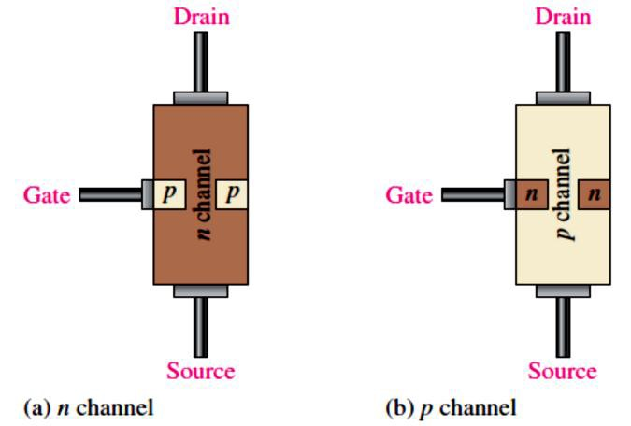
Lecture 8: Field-Effect Transistors (FETS)
FET, the second type of transistor, is a unipolar device because, unlike BJT that use both electron and hole current, it operates only with one type of charge carrier (one-charge carrier).
The two main types of FETs are the junction field-effect transistor (JFET) and the metal oxide semiconductor field-effect transistor (MOSFET).
The term field-effect relates to the depletion region formed in the channel of a FET as a result of a voltage applied on one of its terminals (gate).
A BJT is a current-controlled device: the base current controls the amount of collector current.
A FET is different. It is a voltage-controlled device, where the �_{GS} (gate-to-source voltage) controls the drain current 𝐼_{D} through the device.
A major advantage of FETs is their very high input resistance due to the reverse-biased gate-
source junction.
FETs are the preferred device in low-voltage switching applications
  because they are generally faster than BJTs when turned on and off.
8.1 The JFET
The JFET is a type of FET that operates with a reverse-biased pn junction (gate-to-source) to control current in a channel.
Depending on their structure, as shwon in Figure 8-1, JFETs fall into either of two categories,
n channel or p channel. The three FET terminals are source(S), drain (D), and gate (G).
FIGURE 8-1: A representation of the basic structure of the two types of JFET.
Basic Operation: Figure 8-2 shows dc bias voltages applied to an n-channel device.
�_{DD} provides a �_{DS} and supplies current from drain to source. �_{GG} sets the reverse-bias �_{GS}.
The JFET is always operated with the gate-source pn junction reverse-biased.
  Reverse-biasing of the gate-source junction with a negative gate voltage produces a depletion region along the pn junction, which extends into the n channel and thus increases
its resistance by restricting the channel width.
The channel width and thus the channel resistance can be controlled by varying the �_{GG} =
�_{GS}, thereby controlling the amount of 𝐼_{D}.

Slide 2
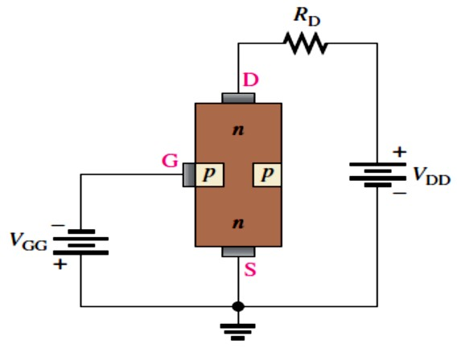
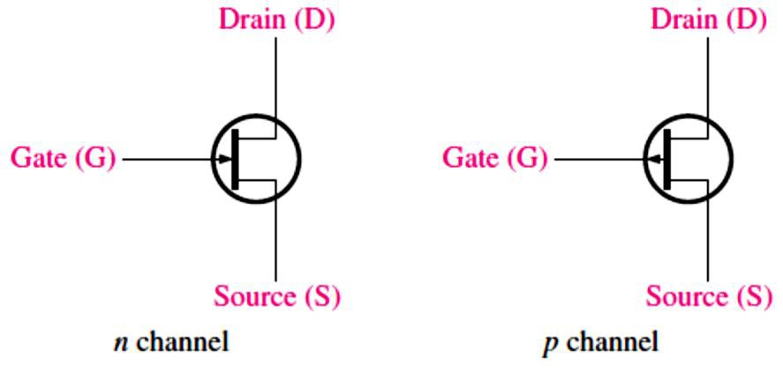
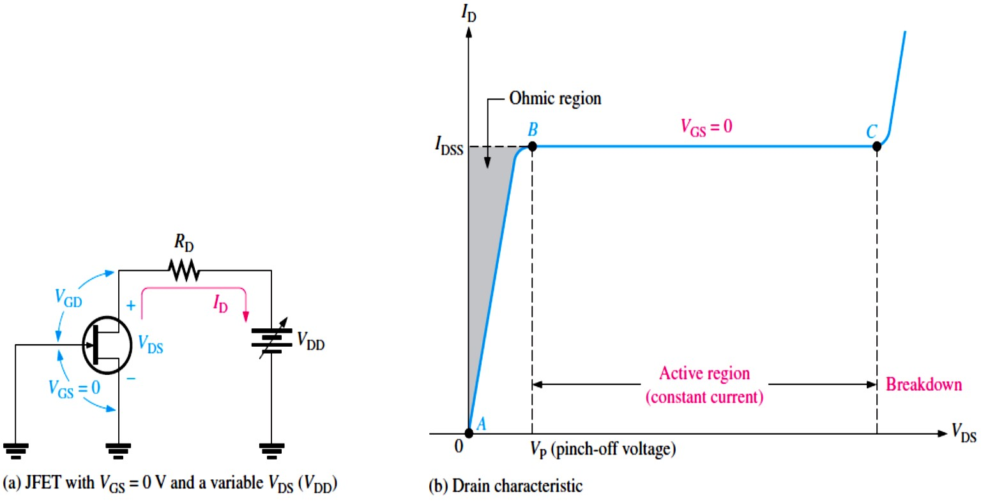
The schematic symbols for both n-channel and p-channel JFETs are shown in Figure 8-3.
FIGURE 8-2: A biased n-channel JFET.
8.2 JFET Characteristics and Parameters
FIGURE 8-3: JFET schematic symbols.
The JFET operates as a voltage-controlled, constant-current device.
Drain Characteristic Curve: when �_{GS} = 0 V. This is produced by shorting the gate to the source, as in Figure 8-4(a) where both are grounded.
For �_{GS} = 0 V, the value of �_{DS} at which 𝐼_{D} becomes constant is the pinch-off voltage �_{P}
(point B on the curve in Figure 8-4(b).
This value of drain current is 𝐼_{DSS} (Drain-to-Source current with gate Shorted).
𝐼_{DSS} is the maximum drain current when �_{GS} = 0 V.
As shown in the graph in Figure 8-4(b), breakdown occurs at point C when 𝐼_{D} begins to increase very rapidly with any further increase in �_{DS}.
FIGURE 8-4: The drain characteristic curve of a JFET for �_{GS} = 0 V showing pinch-off voltage.

Slide 3
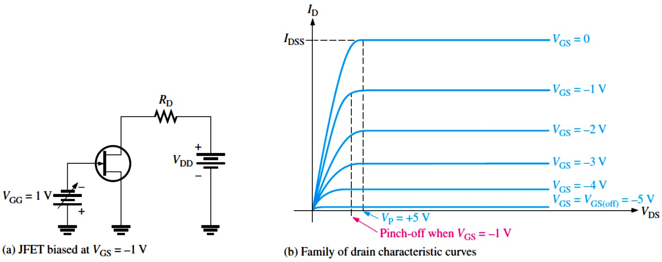
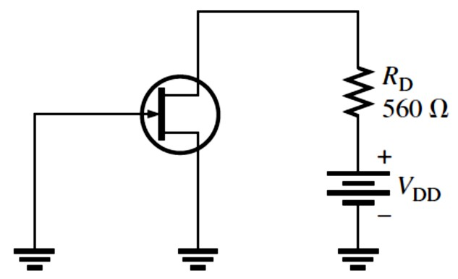
𝑽_{𝐆�}Controls 𝑰_{𝐃}: connect a bias voltage, �_{GG}, from gate to source as shown in Figure 8-5.
For an n-channel JFET, �_{GS} can vary from zero negatively to cutoff, �_{GS(off)}.
For a p-channel JFET, �_{GS} can vary from zero positively to �_{GS(off)}.
Value of �_{GS} at which 𝐼_{D} becomes zero is the cutoff voltage, �_{GS(off)}.
FIGURE 8-5: Pinch-off occurs at a lower �_{DS} as �_{GS} is increased to more negative values.
Comparison of Pinch-Off Voltage and Cutoff Voltage: There is a difference between �_{P} and �_{GS(off)} voltages. There is also a connection.
The �_{P} is the value of �_{DS} at which the 𝐼_{D} becomes constant and equal to 𝐼_{DSS} and is always measured at �_{GS} = 0 V.
Pinch-off occurs for �_{DS} values less than �_{P} when �_{GS} is nonzero. So, although �_{P} is a constant, the minimum value of �_{DS} at which 𝐼_{D} becomes constant varies with �_{GS}.
�_{GS(off)} and �_{P} are always equal in magnitude but opposite in sign.
EXAMPLE 8-1: For the JFET in Figure 8-6, �_{GS(off)} = −4 V and 𝐼_{DSS} = 12 mA. Determine the
minimum value of �_{DD} required to put the device in the constant-current region of operation when
�_{GS} = 0 V.
FIGURE 8-6
Solution Since �_{GS(off)} = −4 V, �_{P} = 4 V (�_{GS(off)} and
�_{P} are always equal in magnitude but opposite in sign). The minimum value of �_{DS} for the JFET to be in its constant-current region is �_{DS} = �_{P} = 4 V. In the constant
-current region with �_{GS} = 0 V, 𝐼_{D} = 𝐼_{DSS} = 12 mA
The drop across the drain resistor is �_{𝑅D} = 𝐼_{D}�_{D} = (12 mA)(560 Ω) = 6.72 V
�_{DD} = �_{DS} + �_{𝑅D} = 4 V + 6.72 V = 10.7 V
This is the value of �_{DD} to make �_{DS} = �_{P} and put the device in the constant-current region.

Slide 4
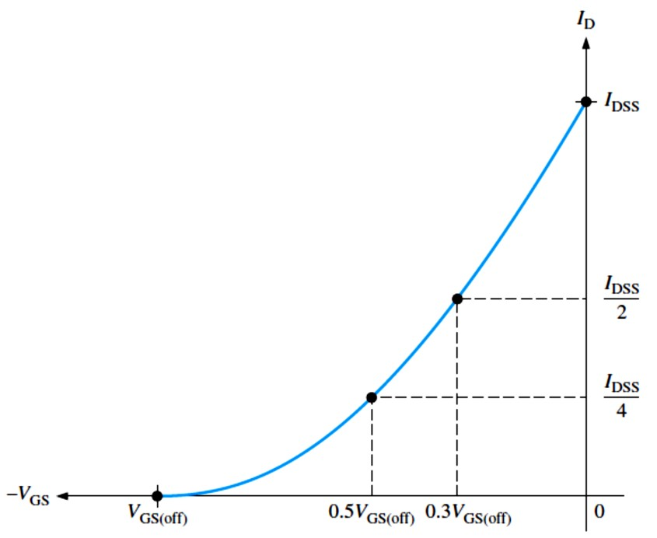
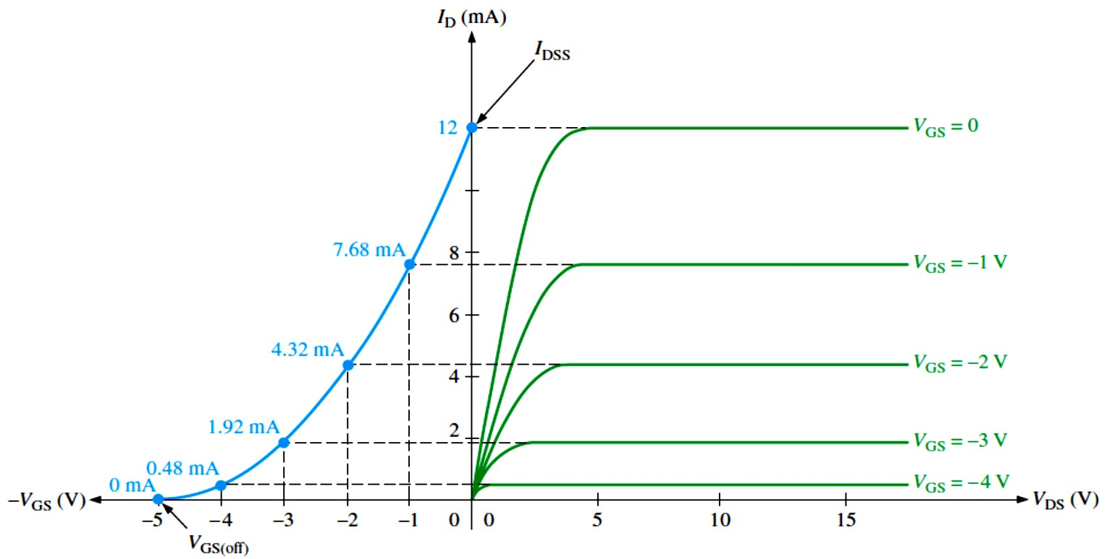
EXAMPLE 8-2: A particular p-channel JFET has a �_{GS(off)} = 4 V. What is 𝐼_{D} when �_{GS} = 6 V? Solution The p-channel JFET requires a positive gate-to-source voltage. The more positive the voltage, the less the drain current. When �_{GS} = +4 V, 𝐼_{D} = 0. Any further increase in �_{GS} keeps the JFET cut off, so 𝐼_{D} remains 0.
JFET Universal Transfer Characteristic: A range of �_{GS} values from zero to �_{GS(off)} controls the amount of drain current.
For an n-channel JFET, �_{GS(off)} is negative, and for a p-channel JFET, �_{GS(off)} is positive.
Figure 8-7 is a general transfer characteristic curve that illustrates graphically the relationship between �_{GS} and 𝐼_{D}. This curve is also known as a transconductance curve.
We can notice that the bottom end of the curve is at a point on the �_{GS} axis equal to �_{GS(off)},
and the top end of the curve is at a point on the 𝐼_{D} axis equal to 𝐼_{DSS}.
This curve shows that
𝐼_{D} = 0
^{when �}GS ^{= �}GS(off) when �_{GS} = 0.5 �_{GS(off)}
𝐼_{D} =
^{𝐼}DSS
4
^{𝐼}DSS
𝐼_{D} =
when �_{GS} = 0.3 �_{GS(off)} when �_{GS} = 0
2
^{𝐼}D ^{= 𝐼}DSS
FIGURE 8-7: JFET universal transfer characteristic curve (n-channel).
The transfer characteristic curve can also be developed from the drain characteristic curves by plotting values of 𝐼_{D} for the values of �_{GS} taken from the family of drain curves at pinch-off, as illustrated in Figure 8-8 for a specific set of curves.
FIGURE 8-8: Example of the development of an n-channel JFET transfer characteristic curve (blue) from the JFET drain characteristic curves (green).

Slide 5
A JFET transfer characteristic curve is expressed approximately as
^{𝑰}𝐃^{≅ 𝑰}𝐃𝐒𝐒^{(� − 𝑽}𝐆�^{⁄𝑽}𝐆�(𝐨��)⁾
�
Equation 8– 1
With Equation 8-1, 𝐼_{D} can be determined for any �_{GS} if �_{GS(off)} and 𝐼_{DSS} are known.
A FET is called a square-law device because of the relationship of 𝐼_{D} to the square of a term containing �_{GS}.
EXAMPLE 8-3: The partial datasheet for a 2N5459 JFET indicates that typically 𝐼_{DSS} = 9 mA and �_{GS(off)} = −8 V (maximum). Using these values, determine the drain current 𝐼_{D} for �_{GS} = 0 V, −1 V, and − 4 V.
Solution For �_{GS} = 0 V, 𝐼_{D} = 𝐼_{DSS} = 9 mA
For �_{GS} = −1 V, we use Equation 8-1.
^{𝐼}D ^{≅ 𝐼}DSS^{(1 − �}GS⁄�GS(off)⁾
For �_{GS} = −4 V,
^{𝐼}D ^{≅ 𝐼}DSS^{(1 − �}GS⁄�GS(off)⁾
2
= (9 mA)(1 − (−1 V)⁄(−8 V))² = 6.89 mA
2
= (9 mA)(1 − (−4 V)⁄(−8 V))² = 2.25 mA
JFET Forward Transconductance: The forward transconductance (transfer conductance), g_{𝑚}, is the change in drain current (∆𝐼_{D}) for a given change in gate-to-source voltage (∆�_{GS}) with the �_{DS} constant. It is expressed as a ratio and has the unit of siemens (S).
g_{𝑚}= ∆𝐼_{D}⁄∆�_{GS}
Given g_{𝑚0} (at �_{GS} = 0 V), we can calculate an approximate value for g_{𝑚}at any point on the transfer characteristic curve using the following formula:
�𝒎^{= �}𝒎�^{(� − 𝑽}𝐆�^{⁄𝑽}𝐆�(𝐨��)⁾
Equation 8– 2
When a value of g_{𝑚0} is not available, we can calculate it using values of 𝐼_{DSS} and �_{GS(off)}.
�𝒎� ^{= �𝑰}𝐃𝐒𝐒^{⁄|𝑽}𝐆�(𝐨��)|
Equation 8– 3
EXAMPLE 8–4: The following information is included on the datasheet for a 2N5457 JFET: typically, 𝐼_{DSS} = 3.0 mA, �_{GS(off)} = −6 V maximum, and g_{𝑓�(𝑚𝑎𝑥)} = 5000 𝜇S. Using these values, determine the forward transconductance for �_{GS} = −4 V, and find 𝐼_{D} at this point. Solution g_{𝑚0} = g_{𝑓�}= 5000 𝜇S. We can use Equation 8–2 to calculate g_{𝑚}.
g_{𝑚}= g_{𝑚0}(1 − �_{GS}⁄�_{GS(off)}) = (5000 𝜇S)(1 − (−4 V)⁄(−6 V)) = 1667 𝜇S
Next, we use Equation 8-1 to calculate 𝐼_{D} at �_{GS} = −4 V.
^{𝐼}D ^{≅ 𝐼}DSS^{(1 − �}GS⁄�GS(off)⁾
2
= (3.0 mA)(1 − (−4 V)⁄(−6 V))² = 333 𝜇A
Input Resistance and Capacitance: A JFET operates with its gate-source junction reverse- biased,

Slide 6
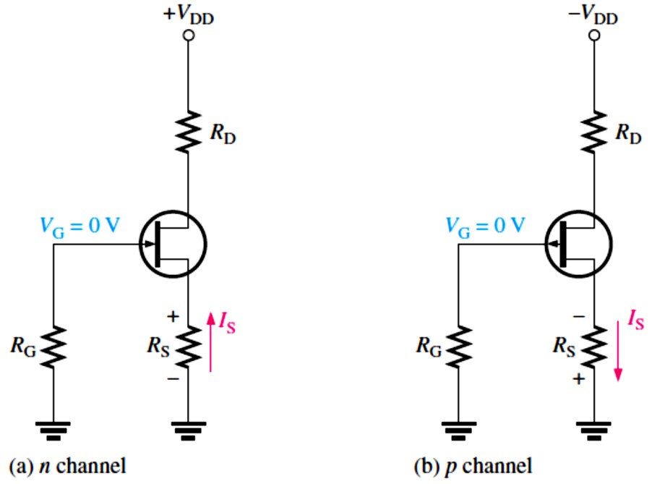
which makes the input resistance at the gate very high. This high input resistance is one advantage of the JFET over the BJT. JFET datasheets often specify the input resistance by giving a value for the gate reverse current, 𝐼_{GSS}, at a certain �_{GS}.
The input resistance can then be determined using the following equation:
�IN ^{= |�}GS^{⁄𝐼}GSS|
EXAMPLE 8–5: A certain JFET has an 𝐼_{GSS} of −2 nA for �_{GS} = −20 V. Determine the input resistance.
Solution �_{IN} = |�_{GS}⁄𝐼_{GSS}| = |−20 V⁄−2 nA| = 10,000 MΩ
AC Drain-to-Source Resistance: We learned from the drain characteristic curve that, above pinch-off, the 𝐼_{D} is relatively constant over a range of �_{DS} voltages.
  Therefore, a large change in �_{DS} produces only a very small change in 𝐼_{D}. The ratio of these changes is the ac drain-to-source resistance of the device, �_{𝑑�}´.
�_{𝑑�}´ =
∆�_{DS}
∆𝐼_{D}
8.3 JFET Biasing
Using some of the JFET parameters discussed previously, we will now see how to dc-bias JFETs.
Just as with the BJT, the purpose of biasing is to select the proper dc gate-to-source voltage to establish a desired value of drain current and, thus, a proper Q-point. Three types of bias are self-bias, voltage-divider bias, and current-source bias.
Self-Bias
Self-bias is the most common type of JFET bias.
JFET must be operated such that the gate-source junction is always reverse-biased. This can be achieved using the self-bias arrangements shown in Figure 8-9.
FIGURE 8-9: Self-biased JFETs (𝐼_{S} = 𝐼_{D} in all FETs).

Slide 7
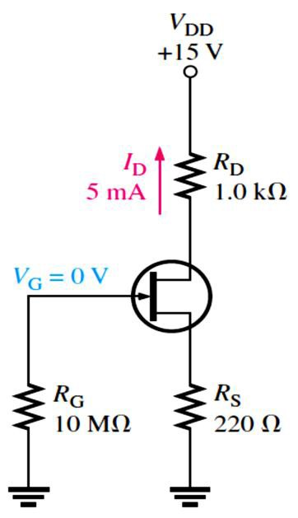
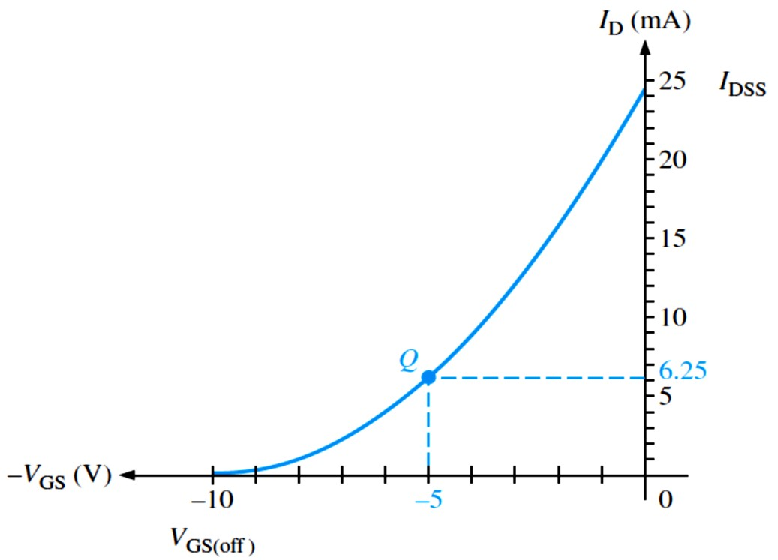
EXAMPLE 8–6: Find �_{DS} and �_{GS} in Figure 8-10. For the particular JFET in this circuit, the parameter values such as g_{𝑚}, �_{GS(off)}, and 𝐼_{DSS} are such that a drain current (𝐼_{D}) of approximately 5 mA is produced. Another JFET, even of the same type, may not produce the same results when connected in this circuit due to the variations in parameter values.
Figure 8-10
Solution
�_{S} = 𝐼_{S}�_{S} = 𝐼_{D}�_{S} = (5 mA)(220 Ω) = 1.1 V
�_{D} = �_{DD} − 𝐼_{D}�_{D} = 15 V − (5 mA)(1.0 kΩ)
�_{D} = 15 V − 5 V = 10 V
Therefore,
�_{DS} = �_{D} − �_{S} = 10 V − 1.1 V = 8.9 V
Since �_{G} = 0 V,
�_{GS} = �_{G} − �_{S} = 0 V − 1.1 V = −1.1 V
Setting the Q-Point of a Self-Biased JFET: The basic approach to establishing a JFET bias point is to determine 𝐼_{D} for a desired value of �_{GS} or vice versa. Then calculate the required value of �_{S} using the following relationship.
�_{S} = |�_{GS}⁄𝐼_{D}|
For a desired value of �_{GS}, 𝐼_{D} can be determined in either of two ways: from the transfer characteristic curve for the particular JFET or, more practically, from Equation 8-1 using
𝐼_{DSS} and �_{GS(off)} from the JFET datasheet.
EXAMPLE 8–7: Determine the value of �_{S} required to self-bias an n-channel JFET that has the transfer characteristic curve shown in Figure 8-11 at �_{GS} = −5 V.
FIGURE 8-11
Solution From the graph,
𝐼_{D} = 6.25 mA when �_{GS} = −5 V. We can calculate �_{S}.
�GS
−5 V
�_{S} = | _{𝐼}
^{| = |}6.25 mA|
D
5 V
�_{S} = _{6.25 mA} = 800 Ω

Slide 8
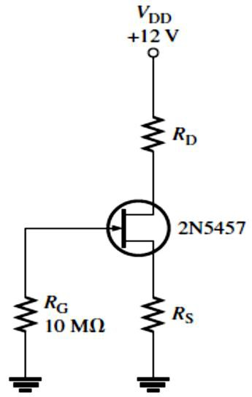
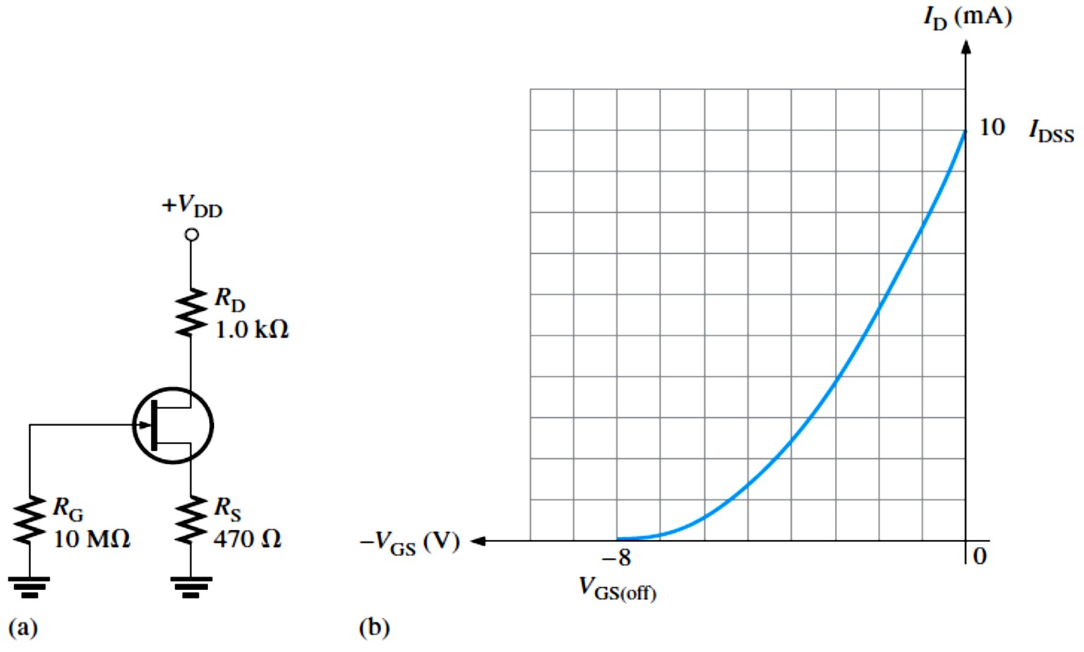
EXAMPLE 8–8: Determine the value of �_{S} required to self-bias a p-channel JFET with datasheet values of 𝐼_{DSS} = 25 mA and �_{GS(off)} = 15 V. �_{GS} is to be 5 V.
Solution We use Equation 8–1 to calculate 𝐼_{D}.
^{𝐼}D ^{≅ 𝐼}DSS^{(1 − �}GS⁄�GS(off)⁾
Now, we can determine �_{S}.
2
= (25 mA)(1 − 5 V⁄15 V)² = 11.1 mA
�_{S} = |�_{GS}⁄𝐼_{D}| = |5 V⁄11.1 mA| = 450 Ω
Midpoint Bias: It is usually desirable to bias a JFET near the midpoint of its transfer characteristic curve where 𝐼_{D} = 𝐼_{DSS}⁄2 obtained by setting �_{GS} ≅ �_{GS(off)}⁄3.4.
EXAMPLE 8-9: Select resistor values for �_{D} and �_{S} in Figure 8-12 to set up an approximate midpoint bias. Use 𝐼_{DSS} = 1.0 mA and �_{GS(off)} = −0.5 V; �_{D} should be approximately 6 V (one- half of �_{DD}).
FIGURE 8-12
Solution For midpoint bias,
𝐼_{D} = 𝐼_{DSS}⁄2 = 1.0 mA⁄2 = 0.5 mA
and �_{GS} ≅ �_{GS(off)}⁄3.4 = −0.5 V⁄3.4 = −147 mV
Then �_{S} = |�_{GS}⁄𝐼_{D}| = |−147 mV⁄0.5 mA| = 294 Ω
�_{D} = �_{DD} − 𝐼_{D}�_{D}
𝐼_{D}�_{D} = �_{DD} − �_{D}
�_{D} = (�_{DD} − �_{D})⁄𝐼_{D} = (12 V − 6 V)⁄0.5 mA = 12 kΩ
Graphical Analysis of a Self-Biased JFET: We can use the transfer characteristic curve of a JFET and certain parameters to determine the Q-point (𝐼_{D} and �_{GS}) of a self-biased circuit shown in Figure 8-13.
If a curve is not available from a datasheet, we can plot it from Equation 8-1 using datasheet values for 𝐼_{DSS} and �_{GS(off)}.
FIGURE 8-13: A self-biased JFET and its transfer characteristic curve.

Slide 9
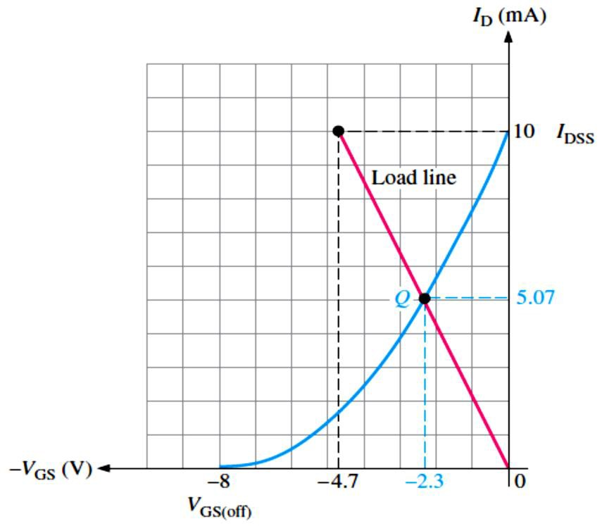
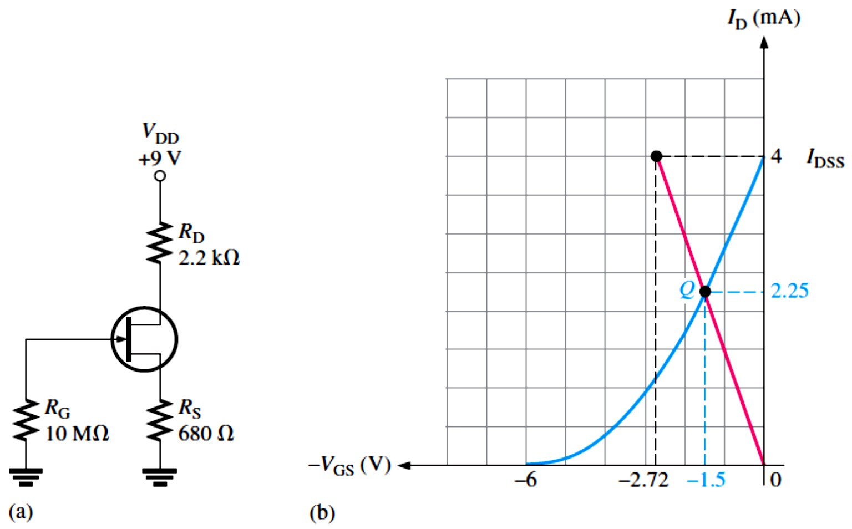
To determine the Q-point of the circuit in Figure 8-13(a), a self-bias dc load line is established on the graph in part (b) as follows:
  First, we calculate �_{GS} when 𝐼_{D} is zero. �_{GS} = −𝐼_{D}�_{S} = (0)(470 Ω) = 0
This establishes a point at the origin on the graph (𝐼_{D} = 0, �_{GS} = 0).
  Next, we calculate �_{GS} when 𝐼_{D} = 𝐼_{DSS}. From the curve in Figure 8-13(b), 𝐼_{DSS} = 10 mA.
�_{GS} = −𝐼_{D}�_{S} = −(10 mA)(470 Ω) = −4.7 V
This establishes a second point on the graph (𝐼_{D} = 10 mA, �_{GS} = −4.7 V ).
Now, with two points, the load line can be drawn on the transfer characteristic curve as shown in Figure 8-14. The point where the load line intersects the transfer characteristic curve is the Q-point of the circuit as shown, where 𝐼_{D} = 5.07 mA and �_{GS} = −2.3 V.
FIGURE 8-14: The intersection of the self-bias dc load line and the transfer characteristic curve is the Q-point.
EXAMPLE 8-10: Determine the Q-point for the JFET circuit in Figure 8-15(a). The transfer characteristic curve is given in Figure 8-15(b).
FIGURE 8-15

Slide 10
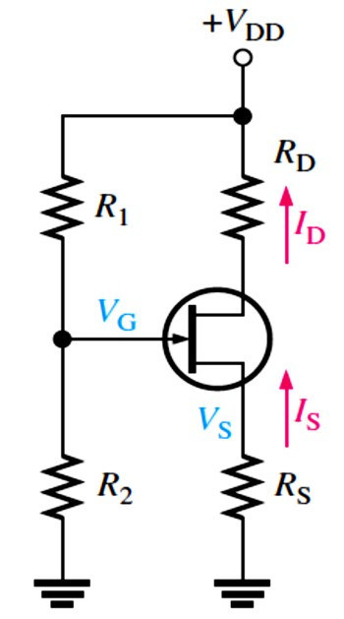
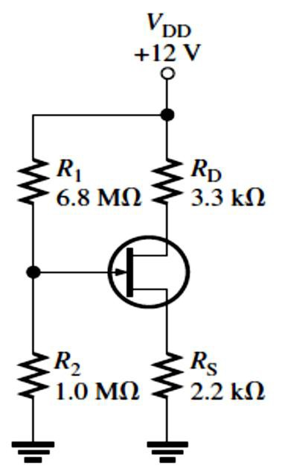
Solution For 𝐼_{D} = 0 A, �_{GS} = −𝐼_{D}�_{S} = −(0)(680 Ω) = 0 V
This gives a point at the origin (𝐼_{D} = 0 , �_{GS} = 0). From the curve, 𝐼_{DSS} = 4 mA; so 𝐼_{D} = 𝐼_{DSS} = 4 mA.
�_{GS} = −𝐼_{D}�_{S} = −(4 mA)(680 Ω) = −2.72 V
This gives a second point at (𝐼_{D} = 4 mA, �_{GS} = −2.72 V). A line is now drawn between the two points, and the values of 𝐼_{D} and �_{GS} at the intersection of the line and the curve are taken from
the graph, as illustrated in Figure 8-15(b). The Q-point values from the graph are
𝐼_{D} = 2.25 mA
�_{GS} = −1.5 V
For increased Q-point stability, the value of �_{S} in the self-bias circuit is increased and connected to a negative supply voltage. This is sometimes called dual-supply bias.
Voltage-Divider Bias: An n-channel JFET with voltage-divider bias is shown in Figure 8-16.
The voltage at the source of the JFET must be more positive than the voltage at the gate in order to keep the gate-source junction reverse-biased.
FIGURE 8-16: An n-channel JFET with voltage-divider bias (𝐼_{S} = 𝐼_{D}).
The source voltage �_{S} is �_{S} = 𝐼_{D}�_{S}
The gate voltage �_{G} is set by resistors �₁ and �₂ as expressed by the following equation using the voltage-divider formula:
�_{G} = (�₂⁄�₁ + �₂)�_{DD}
The gate-to-source voltage �_{GS} is �_{GS} = �_{G} − �_{S}
and the source voltage �_{S} is �_{S} = �_{G} − �_{GS}
The drain current 𝐼_{D} can be expressed as 𝐼_{D} = 𝐼_{S} = �_{S}⁄�_{S}
Substituting for �_{S},
𝐼_{D} = (�_{G} − �_{GS})⁄�_{S}
EXAMPLE 8-11: Determine 𝐼_{D} and �_{GS} for the JFET with voltage-divider bias in Figure 8-17, given that for this particular JFET the parameter values are such that �_{D} ≅ 7 V.
FIGURE 8-17
Solution
𝐼_{D} = (�_{DD} − �_{D})⁄�_{D} = (12 V − 7 V)⁄3.3 kΩ = 1.52 mA
�_{S} = 𝐼_{D}�_{S} = (1.52 mA)(2.2 kΩ) = 3.34 V
�_{G} = (�₂⁄(�₁ + �₂))�_{DD} = (1.0 MΩ⁄(6.8 MΩ + 1.0 MΩ))12 V
�_{G} = 1.54 V
�_{GS} = �_{G} − �_{S} = 1.54 V − 3.34 V = −1.8 V
If �_{D} had not been given in this example, the Q-point values
could not have been found without the transfer characteristic curve.
10

Slide 11
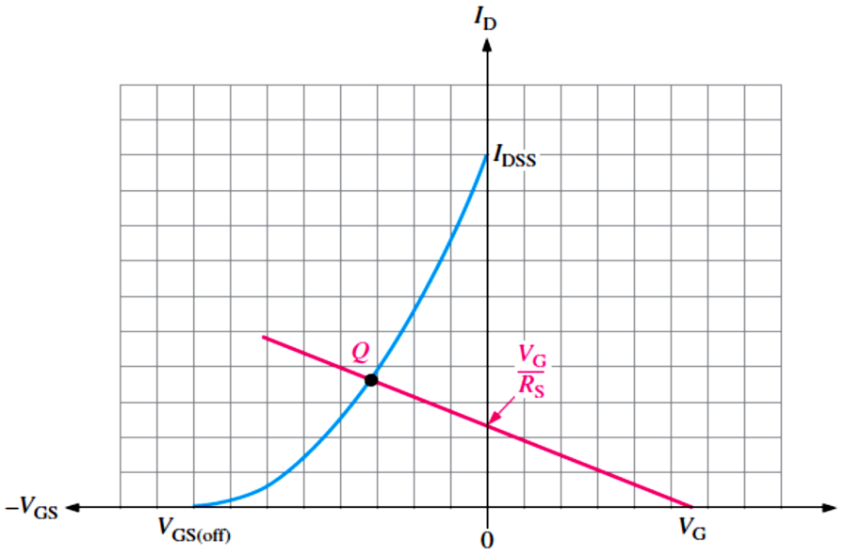
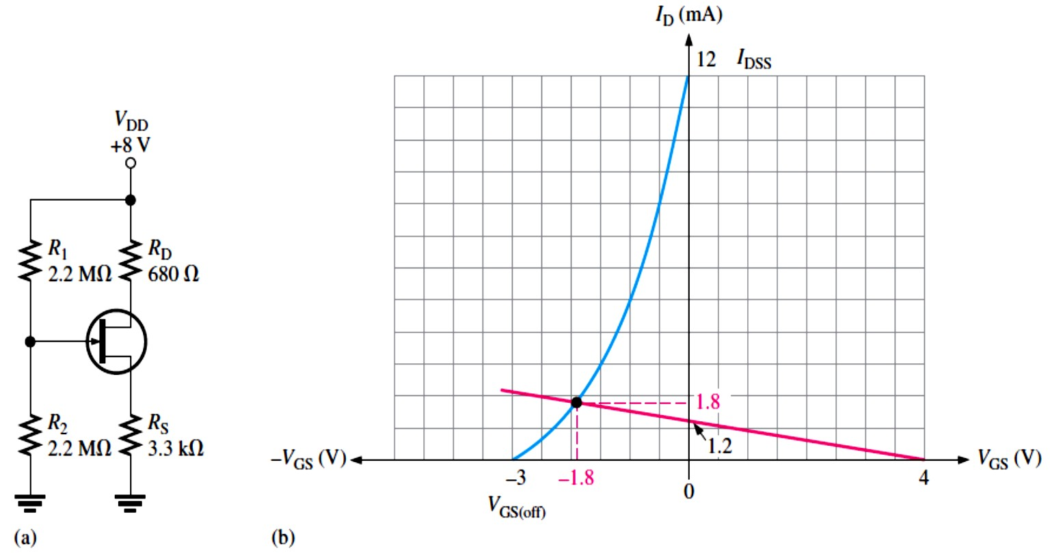
Graphical Analysis of a JFET with Voltage-Divider Bias: An approach similar to the one used for self-bias can be used with voltage-divider bias to graphically determine the Q-point of a circuit on the transfer characteristic curve.
In a JFET with voltage-divider bias when 𝐼_{D} = 0, �_{GS} is not zero, as in the self-biased case,
because the voltage divider produces a voltage at the gate independent of the drain current.
The voltage-divider dc load line is determined as follows:
➢ For 𝐼_{D} = 0, �_{S} = 𝐼_{D}�_{S} = (0)�_{S} = 0 V
�_{GS} = �_{G} − �_{S} = �_{G} − 0 V = �_{G}
Therefore, one point on the line is at 𝐼_{D} = 0 and �_{GS} = �_{G}.
➢ For �_{GS} = 0, 𝐼_{D} = (�_{G} − �_{GS})⁄�_{S} = (�_{G} − 0)⁄�_{S} = �_{G}⁄�_{S}
A second point on the line is at 𝐼_{D} = �_{G}⁄�_{S} and �_{GS} = 0.
The generalized dc load line is shown in Figure 8-18. The point at which the load line intersects the transfer characteristic curve is the Q-point.
FIGURE 8-18: Generalized dc load line (red) for a JFET with voltage-divider bias.
EXAMPLE 8-12: Determine the approximate Q-point for the JFET with voltage-divider bias in Figure 8-19(a), given that this particular device has a transfer characteristic curve as shown in Figure 8-19(b).
FIGURE 8-19

Slide 12
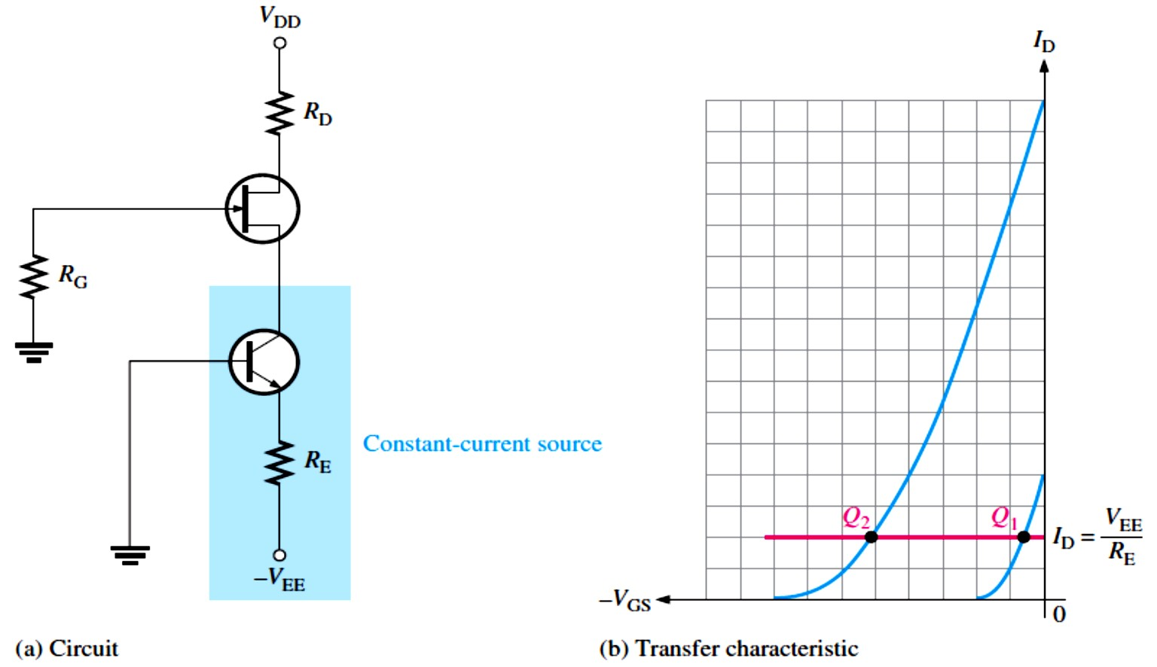
Solution First, we establish the two points for the load line. For 𝐼_{D} = 0,
�_{GS} = �_{G} = (�₂⁄(�₁ + �₂))�_{DD} = (2.2 MΩ⁄(2.2 MΩ + 2.2 MΩ))8 V = 4 V
The first point is at 𝐼_{D} = 0 and �_{GS} = 4 V. For �_{GS} = 0,
𝐼_{D} = (�_{G} − �_{GS})⁄�_{S} = (�_{G} − 0)⁄�_{S} = �_{G}⁄�_{S} = 4 V⁄3.3 kΩ = 1.2 mA
The second point is at 𝐼_{D} = 1.2 mA and �_{GS} = 0.
The load line is drawn in Figure 8-19(b), and the approximate Q-point values of 𝐼_{D} ≅ 1.8 mA and
�_{GS} ≅ −1.8 V are picked off the graph, as indicated.
Q-Point Stability: Figure 8-20 illustrates Q-point stability for a self-biased JFET and for a JFET with voltage-divider bias.
With voltage-divider bias, the dependency of 𝐼_{D} on the range of Q-points is reduced because the slope of the load line is less than for self-bias for a given JFET. Although �_{GS} varies quite
a bit for both self-bias and voltage-divider bias, 𝐼_{D} is much more stable with voltage-divider bias.
  The Q-point in a JFET with voltage-divider bias is more stable than in a self-biased JFET.
Current-Source Bias: Current-source bias increases the Q-point stability of a self-biased.
  This is accomplished by using a constant-current source in series with the JFET source, as shown in Figure 8-20(a).
  In this circuit, a BJT acts as the constant-current source because its emitter current is essentially constant if �_{EE} ≫ �_{BE}. A FET can also be used as a constant-current source.
𝐼_{E} = (�_{EE} − �_{BE})⁄�_{E} ≅ �_{EE}⁄�_{E}
Since 𝐼_{E} ≅ 𝐼_{D},
𝐼_{D} ≅ �_{EE}⁄�_{E}
    As we can see in Figure 8-20(b), 𝐼_{D} remains constant for any transfer characteristic curve, as indicated by the horizontal load line.
FIGURE 8-20:
Current-source bias.

Slide 13
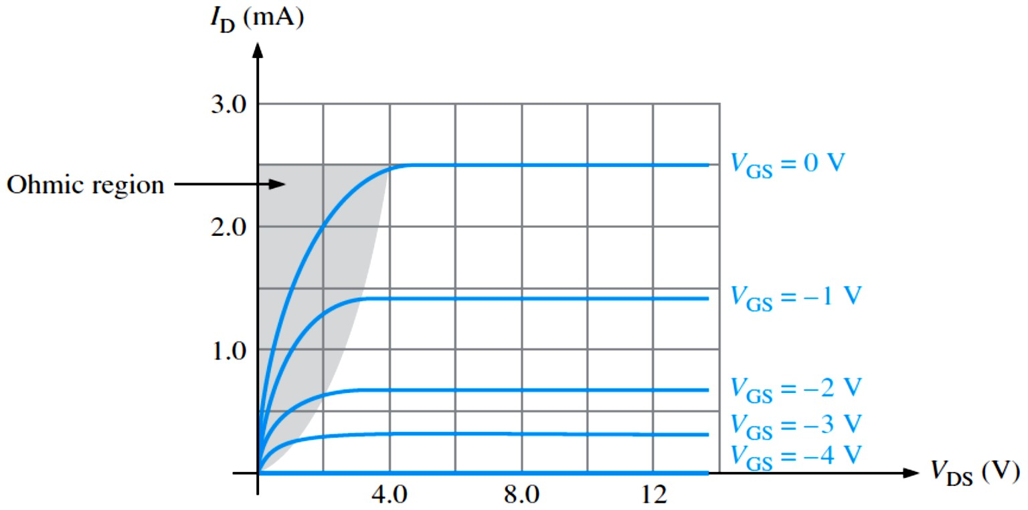
EXAMPLE 8-13: A current-source bias circuit like Figure 8-20 has the following values: �_{DD} = 9 V, �_{EE} = −6 V, and �_{G} = 10 MΩ. To produce a 10 mA drain current and a 5 V drain voltage, determine the values of �_{E} and �_{D}.
Solution �_{E} = �_{EE}⁄𝐼_{D} = −(−6 V)⁄10 mA = 600 Ω
�_{D} = (�_{DD} − �_{D})⁄𝐼_{D} = (9 V − 5 V)⁄10 mA = 400 Ω
8.4 The Ohmic Region
The ohmic region (as shown in Figure 8-21) is the portion of the FET characteristic curves in which Ohm’s law can be applied.
A JFET biased in the ohmic region exhibits the properties of a variable resistance, where the value of resistance is controlled by �_{GS}.
To bias in the ohmic region, 𝐼_{D} must be much smaller than 𝐼_{DSS}.
The �_{GS} controls �_{DS} in the ohmic region.
When a JFET is biased at the origin (�_{DS} = 0 V, 𝐼_{D} = 0 mA), the ac channel resistance is
controlled by the �_{GS}.
The slope of the characteristic curve in this region is the dc drain-to-source conductance 𝐺_{DS}.
Slope = 𝐺_{DS} ≅ 𝐼_{D}⁄�_{DS}
The resistance is the reciprocal of the 𝐺_{DS}. Thus, the dc drain-to-source resistance is
�_{DS} = 1⁄Slope = 1⁄𝐺_{DS} ≅ �_{DS}⁄𝐼_{D}
FIGURE 8-21:
The ohmic region is the shaded area.
EXAMPLE 8-14: An n-channel JFET is biased in the ohmic region as shown in Figure 8-22. The graph shows an expanded section of the load line in the ohmic region. As �_{GS} is varied from 0 V to −3 V as indicated, assume that the graph shows the following Q-point values:
�₀: 𝐼_{D} = 0.360 mA, �_{DS} = 0.13 V, �₁: 𝐼_{D} = 0.355 mA, �_{DS} = 0.27 V, �₂: 𝐼_{D} = 0.350 mA, �_{DS} = 0.42 V, �₃: 𝐼_{D} = 0.33 mA, �_{DS} = 0.97 V
Determine the range of �_{DS} as �_{GS} is varied from 0 V to −3 V.

Slide 14
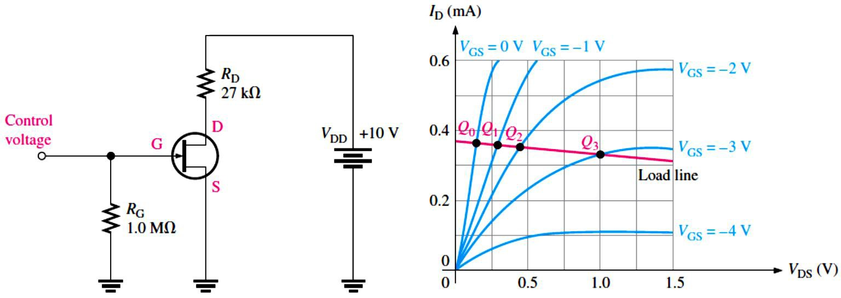
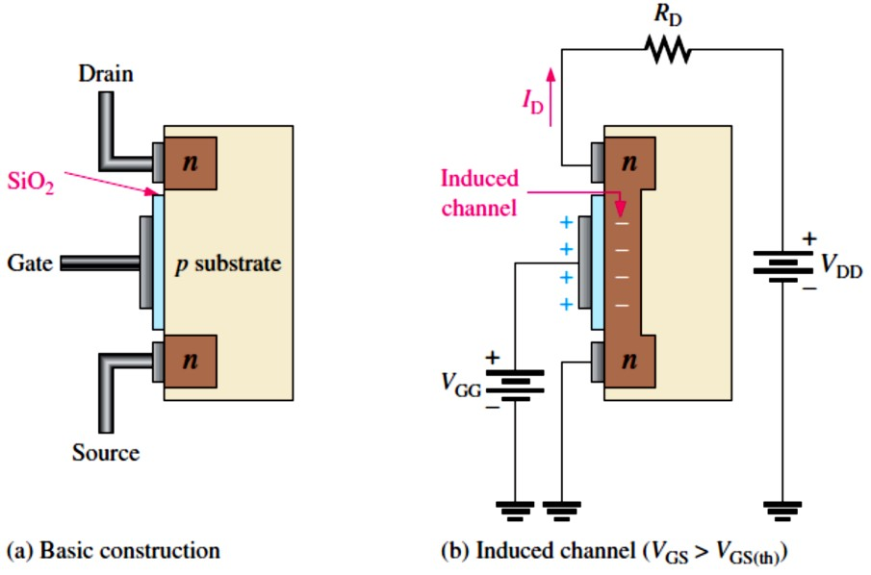
FIGURE 8-22
Solution
�₀: �_{DS} = �_{DS}⁄𝐼_{D} = 0.13 V⁄0.360 mA = 361 Ω
�₁: �_{DS} = �_{DS}⁄𝐼_{D} = 0.27 V⁄0.355 mA = 760 Ω
�₂: �_{DS} = �_{DS}⁄𝐼_{D} = 0.42 V⁄0.350 mA = 1.2 kΩ
�₃: �_{DS} = �_{DS}⁄𝐼_{D} = 0.97 V⁄0.33 mA = 2.9 kΩ
When �_{GS} is varied from 0 V to −3 V, 𝑹_{𝐃�}changes from �𝟔� 𝛀to �. 𝟗𝐤�.
8.5 The MOSFET
The MOSFET is another category of field-effect transistor.
MOSFETs differ from JFETs in that the gate of a MOSFET is insulated from the channel by an 𝐒�𝐎� layer, whereas the gate and channel in a JFET are separated by a pn junction.
The two basic types of MOSFETs are enhancement (E) and depletion (D).
Enhancement MOSFET: The E-MOSFET (shown in Figure 8-23) operates only in the enhancement mode and has no physical channel.
A channel is induced in an E-MOSFET by the application of a �_{GS} >threshold value, �_{GS(th)}.
For an n-channel device, a positive �_{GS} above a �_{GS(th)} induces a channel by creating a thin layer of negative charges in the substrate region adjacent to the SiO₂ layer.
Value of �_{GS} at which 𝐼_{D} begins is the threshold voltage, �_{GS(th)}.
For any �_{GS} below the �_{GS(th)} value, there is no channel.
Unlike JFETs and D-MOSFETs, the E-MOSFET cannot operate with �_{GS} = 0 V.
FIGURE 8-23: Representation of the basic E-MOSFET construction and operation (n-channel).

Slide 15
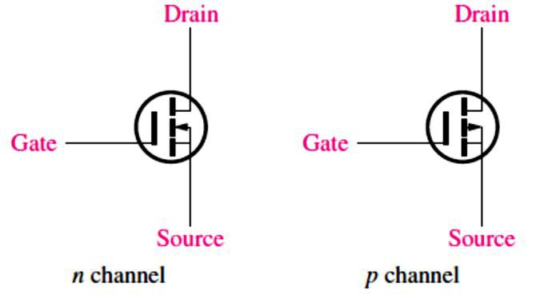
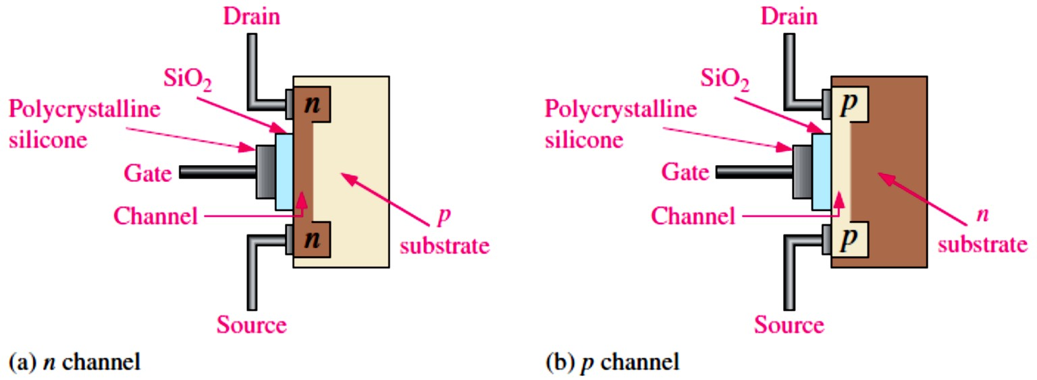
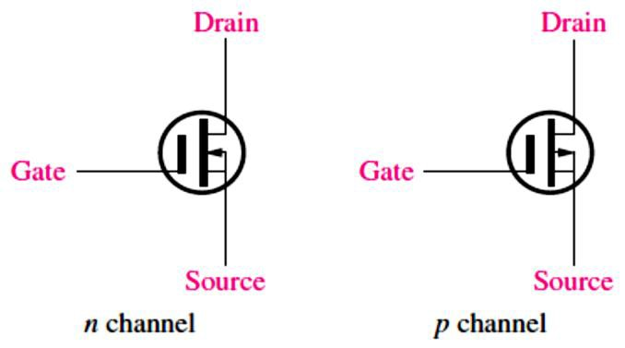
The schematic symbols for the n- and p-channel E-MOSFETs are shown in Figure 8-24.
FIGURE 8-24: E-MOSFET schematic symbols.
Depletion MOSFET (D-MOSFET): The D-MOSFET (shown in Figure 8-25) can be operated in either of two modes: the depletion mode or the enhancement mode, and is sometimes called a depletion/enhancement MOSFET.
FIGURE 8-25:
Representation of the basic structure of D-MOSFETs.
The D-MOSFET has a physical channel between the drain and source.
For an n-channel D-MOSFET, negative values of �_{GS} produce the depletion mode and positive
values produce the enhancement mode.
The schematic symbols for both the n-channel and the p-channel depletion MOSFETs are shown in Figure 8-26.
FIGURE 8-26: D-MOSFET schematic symbols.
8.6 MOSFET Characteristics and Parameters
Much of the discussion concerning JFET characteristics and parameters applies equally to MOSFETs. In this section, MOSFET parameters are discussed.
E-MOSFET Transfer Characteristic: An E-MOSFET has no 𝐼_{DSS} parameter. It is extremely small, if specified (ideally 0).
An n-channel E-MOSFET has a positive �_{GS(th)}. A p-channel E-MOSFET has a negative
�GS(th).

Slide 16
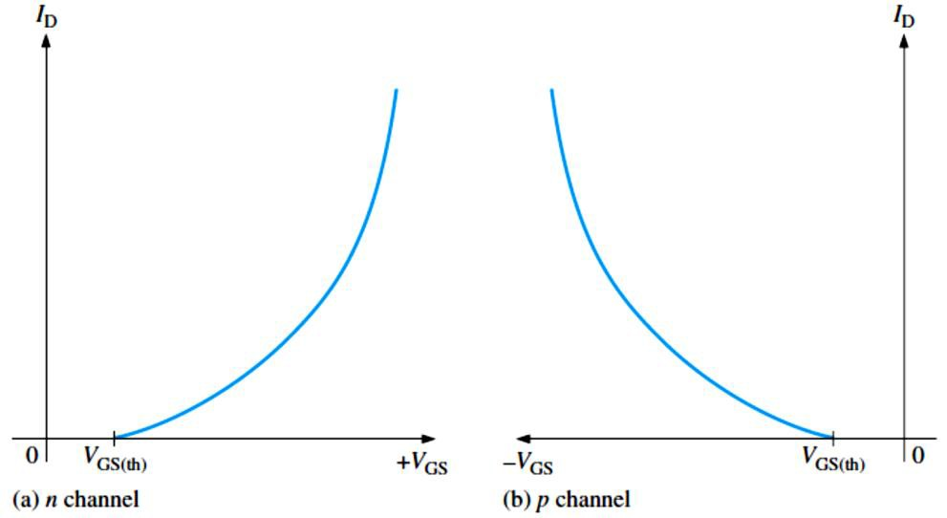
The transfer characteristic curves (shown in Figure 8-27) for both types of E-MOSFETs do not intersect the 𝐼_{D} axis. The equation for the E-MOSFET transfer characteristic curve is
^{𝑰}𝐃^{= 𝑲( 𝑽}𝐆�^{− 𝑽}𝐆�(𝐭�)⁾
�
Equation 8– 4
The constant K depends on the particular MOSFET and can be determined from the datasheet by taking the specified value of 𝐼_{D}, called 𝐼_{D(on)}, at the given value of �_{GS} and substituting the values into Equation 8–4 as illustrated in Example 8–16.
FIGURE 8-27: E-MOSFET general
transfer characteristic curves.
EXAMPLE 8-16: The datasheet for a 2N7002 E-MOSFET gives 𝐼_{D(on)} = 500 mA (minimum) at �_{GS} = 10 V and �_{GS(th)} = 1 V. Determine the drain current for �_{GS} = 5 V.
Solution First, we solve for K using Equation 8-4.
^{𝐼}D ^{= 𝐾( �}GS ^{− �}GS(th)⁾
2
^{𝐾= 𝐼}D(on)^{⁄( �}GS ^{− �}GS(th)⁾
2
= 500 mA ⁄( 10 V − 1 V)² = 500 mA⁄81 V² = 6.17 mA⁄V²
Next, by using the value of K, we can calculate 𝐼_{D} for �_{GS} = 5 V.
^{𝐼}D ^{= 𝐾( �}GS ^{− �}GS(th)⁾
2
= (6.17 mA⁄V²)( 5 V − 1 V)² = 98.7 mA
D-MOSFET Transfer Characteristic: As previously discussed, the D-MOSFET can operate with either positive or negative gate voltages.
This is indicated on the general transfer characteristic curves in Figure 8-28 for both n-channel and p-channel MOSFETs.
The transfer characteristic curve for a D-MOSFET intersects the vertical 𝐼_{D} axis.
Value of �_{GS} at which 𝐼_{D} becomes zero is the cutoff voltage, �_{GS(off)}.
𝐼_{DSS} is drain current when �_{GS} = 0 V.
The square-law expression in Equation 8–1 for the JFET curve also applies to the D-MOSFET curve, as Example 8-17 demonstrates.
�
𝑰_{𝐃}≅ 𝑰_{𝐃𝐒𝐒}(� − _{𝑽}
^{𝑽}𝐆�
)
𝐆�(𝐨��)

Slide 17
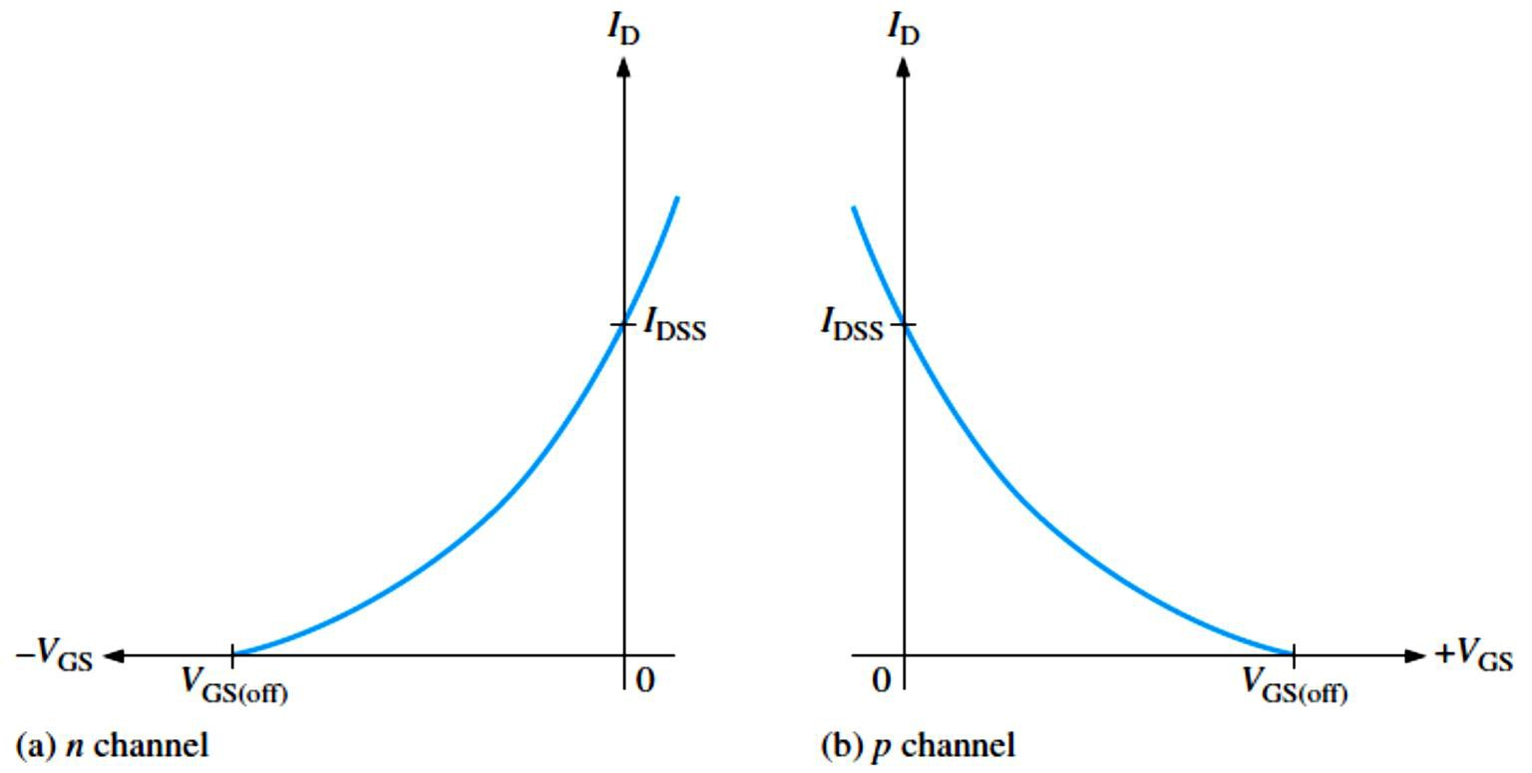
FIGURE 8-28: D-MOSFET general
transfer characteristic curves.
EXAMPLE 8-17: For a certain D-MOSFET, 𝐼_{DSS} = 10 mA and �_{GS(off)} = −8 V.
(a) Is this an n-channel or a p-channel? (b) Calculate 𝐼_{D} at �_{GS} = −3 V. (c) Calculate 𝐼_{D} at
�_{GS} = +3 V.
Solution (a) The device has a negative �_{GS(off)}; therefore, it is an n-channel MOSFET.
^{(b) 𝐼}D ^{≅ 𝐼}DSS^{(1 − �}GS⁄�GS(off)⁾
2
= (10 mA)(1 − (−3 V)⁄(−8 V))² = 3.91 mA
= (10 mA)(1 − (+3 V)⁄(−8 V))² = 18.9 mA
^{(c) 𝐼}D ^{≅ 𝐼}DSS^{(1 − �}GS⁄�GS(off)⁾
2
Note: All MOS devices are subject to damage from electrostatic discharge (ESD). Because the gate of a MOSFET is insulated from the channel, the input resistance is extremely high (ideally infinite). The gate leakage current, 𝐼_{GSS}, for a typical MOSFET is in the pA range, whereas the gate reverse current for a typical JFET is in the nA range. The input capacitance results from the insulated gate structure. Excess static charge can be accumulated because the input capacitance combines with the very high input resistance and can result in damage to the device.
8.7 MOSFET Biasing
Three ways to bias a MOSFET are: zero-bias, voltage-divider bias, and drain-feedback bias.
Biasing is important in FET amplifiers.
E-MOSFET Bias: Because E-MOSFETs must have a �_{GS} greater than the �_{GS(th)}, zero bias
cannot be used.
Figure 8-29 shows two ways to bias an E-MOSFET (D-MOSFETs can also be biased using these methods).
In either the voltage-divider or drain-feedback bias arrangement, the purpose is to make the
gate voltage more positive than the source by an amount exceeding �_{GS(th)}.
Equations for the analysis of the voltage-divider bias in Figure 8-29(a) are as follows:

Slide 18
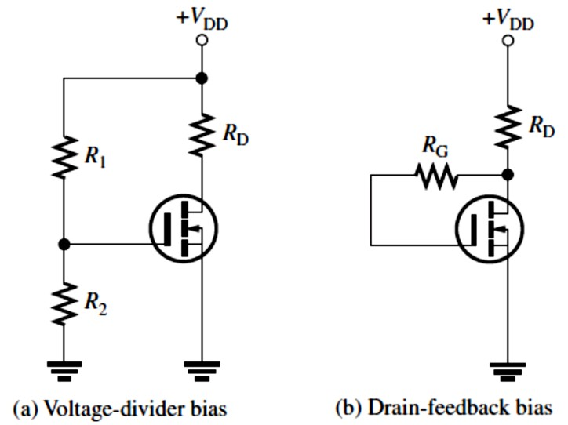
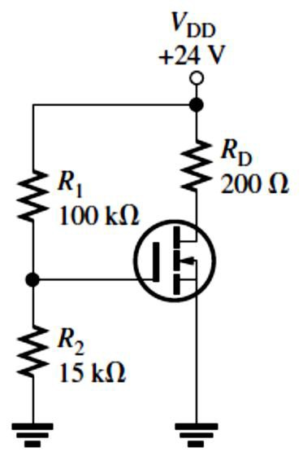
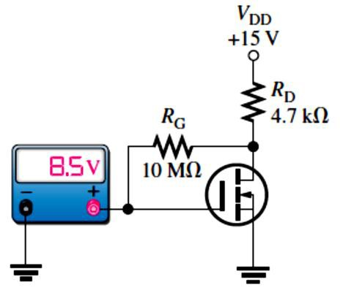
�_{GS} = (�₂⁄(�₁ + �₂))�_{DD}
�_{DS} = �_{DD} − 𝐼_{D}�_{D}
2
where 𝐼_{D} = 𝐾( �_{GS} − �_{GS(th)}) from Equation 8-4.
In the drain-feedback bias circuit in Figure 8-29(b), there is negligible gate current and, therefore, no voltage drop across �_{G}. This makes �_{GS} = �_{DS}
FIGURE 8-29: Common E-MOSFET biasing arrangements.
EXAMPLE 8-18: Determine �_{GS} and �_{DS} for the E-MOSFET circuit in Figure 8-30. Assume this particular MOSFET has minimum values of 𝐼_{D(on)} = 200mA at �_{GS} = 4V and �_{GS(th)} = 2 V.
FIGURE 8-30
Solution For the E-MOSFET in Figure 8-30, the gate-to-source voltage is
�_{GS} = (�₂⁄(�₁ + �₂))�_{DD} = (15 kΩ⁄(100 kΩ + 15 kΩ))24 V
�_{GS} = 3.13 V
To determine �_{DS}, first we find K using the minimum value of 𝐼_{D(on)} and the specified voltage values.
^{𝐾= 𝐼}D(on)^{⁄( �}GS ^{− �}GS(th)⁾
2
= 200 mA⁄( 4 V − 2 V)²
𝐾= 200 mA⁄4 V² = 50 mA⁄V²
Now we calculate 𝐼_{D} for �_{GS} = 3.13 V.
^{𝐼}D ^{= 𝐾( �}GS ^{− �}GS(th)⁾
2
= (50 mA⁄V²)( 3.13 V − 2 V)² = 63.8 mA
Finally, we calculate �_{DS}. �_{DS} = �_{DD} − 𝐼_{D}�_{D} = 24 V − (63.8 mA)(200 Ω) = 11.2 V
EXAMPLE 8-19: Determine the amount of drain current in Figure 8-31. The MOSFET has a
�GS(th) ^{= 3 V.}
FIGURE 8-31
Solution The meter indicates �_{GS} = 8.5 V.
Since this is a drain-feedback configuration,

Slide 19
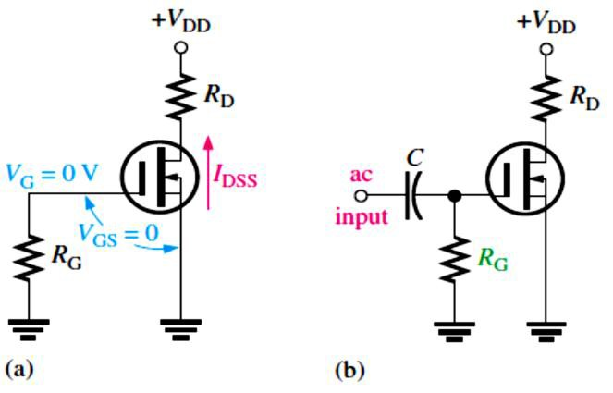
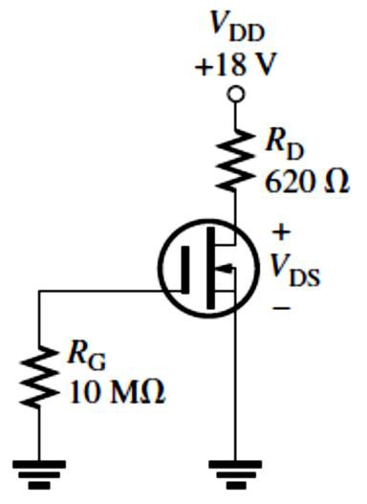
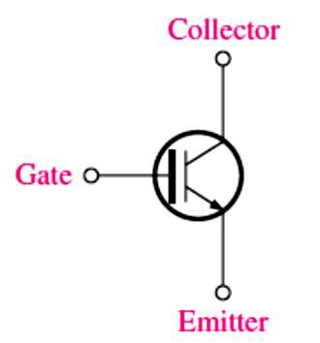
�_{DS} = �_{GS} = 8.5 V; �_{DS} = �_{DD} − 𝐼_{D}�_{D}
𝐼_{D} =
�DD ^{− �}DS
15 V − 8.5 V
�
= = 1.38 mA
D
4.7 kΩ
D-MOSFET Bias: Midpoint bias for a D-MOSFET is 𝐼_{D} = 𝐼_{DSS} obtained by setting �_{GS} = 0 V so that an ac signal at the gate varies the gate-to-source voltage above and below this 0 V bias point.
A MOSFET with zero bias is shown in Figure 8-32(a). The �_{DS} is:
�DS ^{= �}DD ^{− 𝐼}DSS�D
The purpose of �_{G} is to accommodate an ac signal input by isolating it from ground, as shown
in Figure 8-32(b).
FIGURE 8-32: A zero-biased D-MOSFET.
EXAMPLE 8-20: Determine the drain-to-source voltage in the circuit of Figure 8-33. The MOSFET datasheet gives �_{GS(off)} = −8 V and 𝐼_{DSS} = 12 mA.
FIGURE 8-33
Solution
Since 𝐼_{D} = 𝐼_{DSS} = 12 mA, the drain-to-source voltage is
�_{DS} = �_{DD} − 𝐼_{DSS}�_{D} = 18 V − (12 mA)(620 Ω) = 10.6 V
8.8 The IGBT
The IGBT (insulated-gate bipolar transistor) combines features from both the MOSFET (Voltage controlled) and the BJT that make it useful in high-voltage and high-current switching applications.
The IGBT (shown in Figure 8-34) has three terminals: gate, collector, and emitter.
FIGURE 8-34: A symbol for the IGBT (insulated-gate bipolar transistor).

